Slide 1

Factors Associated with Attrition of Girls Students from School in Bangladesh
Presented by
Mohammad Nayeem Hasan
Department of Statistics, Shahjalal University of Science & Technology, Bangladesh

Slide 2
Content
Background
Objective
Methods
  Study design
  Response variable
  Predictor variables
  Statistical analysis
Ethics approval
Results
Conclusion
References
Acknowledgement

Slide 3
Background
Educating girls is crucial to development, well-educated girls have better income and fewer hesitation, healthier and enhanced educated children compare with more than the boys [1].
The rate of girls drop out from school remains high in many low-income countries where over half of the girls who start primary school cannot finish their education [2].
As compared to boys the attrition rate is higher for girls in 49 countries [3].
Higher attrition in high school level education (13-16 years), especially for girls, where gendered social and school experiences combined with financial, marital and childbearing roles, etc., to discourage teenage girls' contribution [4].
Notes:
Factors Associated with Attrition of Girls Students from School in Bangladesh

Slide 4
Objective
This paper aims to find out the factors of school dropout among Bangladeshi girls. The three important questions that this study sought to answer are as follows:
  How common is school dropout?
  How much more likely (or less likely) is school attendance and school dropout?
  Who is more likely to leave school?

Slide 5
Methods
Study design
We used the 2012-13 Bangladesh multiple indicator cluster survey (MICS) data.
It is based on a sample of 51895 households (43474 rural, 8421 urban) interviewed with a response rate of 98.5% and provides a comprehensive picture of children and girls.
From the interviewed households, 59599 girls (age 15-49 years) were identified and 51791 were successfully interviewed with the response rate of 89.3%.
The girls' age ranged from 15 to 17 years and ever attended school (n=4800) were included, otherwise excluded from the analysis.
Notes:
Factors Associated with Attrition of Girls Students from School in Bangladesh

Slide 6
Methods
Response variable
In this study, the dependent variable is the school attrition. Attrition is identified by a woman, was ever attended school but not in school in the current school year prior to the data collection.
Notes:
Factors Associated with Attrition of Girls Students from School in Bangladesh

Slide 7
Methods
Predictor variables
Several demographic and socio-economic factors are associated with the girl’s school attrition.
Predictor variables based on the previous study [5,6,7–9] are included in this study.
Predictor Variables | Values
Girl's age (Year) | 15,16,17
Marital status | Married, Unmarried
Area | Rural, Urban
Divisions | Barisal, Chittagong, Dhaka, Khulna, Rajshahi, Rangpur, Sylhet
Household wealth index | Poorest, Poor, Middle, Rich, Richest
Household education | None, Primary incomplete, Primary complete, Secondary Incomplete, Secondary complete
Religion | Islam, Others
Mother alive | Yes, No
Father alive | Yes, No
Notes:
Factors Associated with Attrition of Girls Students from School in Bangladesh

Slide 8
Methods
Statistical analysis
Analysis was carried out in two stages. In the first stage, Chi-Square test was carried out. In second stage, a multiple logistic regression was carried out.
The multiple logistic regression model includes the independent variables: age, marital status, area, division, wealth index, religion, mother alive, father alive and household education.
Logistic regression was applied and odds ratios (ORs) with 95 % CI were used to evaluate the factors associated with school attrition among 15-17 years aged girls.
The statistical analysis and data management for this study has been carried out using R (survey package) and SPSS (IBM SPSS 25).
Notes:
Factors Associated with Attrition of Girls Students from School in Bangladesh

Slide 9
Ethics Approval
Our study was wholly based on an analysis of existing public domain health survey datasets obtained from Bangladesh Multiple Indicator Cluster Survey (MICS) collected in 2012–13, which were collected from eligible respondents’.
The procedures were reviewed and approved by the national statistical office, Bangladesh Bureau of Statistics (BBS) and UNICEF.
Because this study involves secondary data analyses of a publicly available dataset which are freely available on the UNICEF website (http://www.mics.unicef.org/) with all identifier information removed, ethical approval from respective institutions was not required.
Notes:
Factors Associated with Attrition of Girls Students from School in Bangladesh

Slide 10
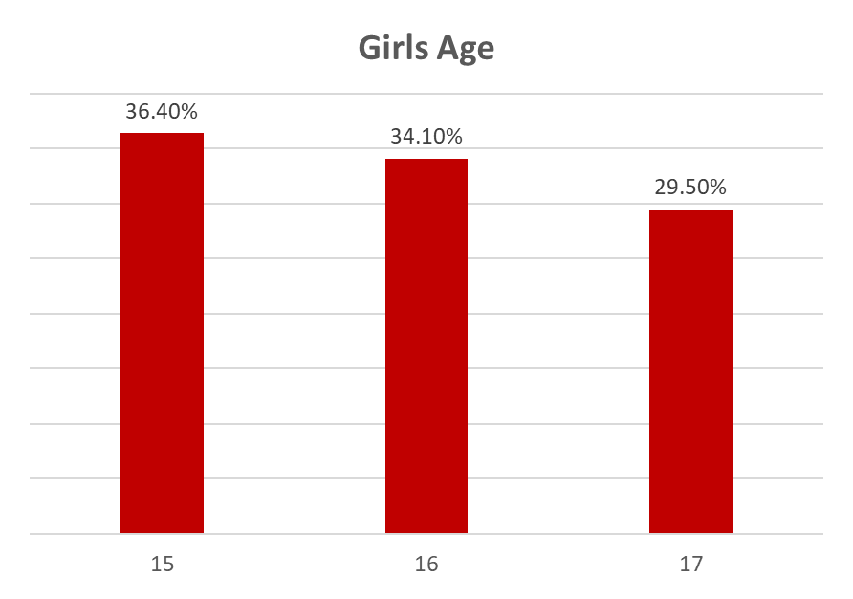
Results
A TOTAL OF 4800 GIRLS GENERATED AS A SUBSAMPLE. AMONG THEM, 15 (36.40%), 16 (34.10%) AND 17-YEAR-OLD (29.50%) GIRLS WERE INCLUDED IN THE ANALYSIS, RESPECTIVELY

Slide 11
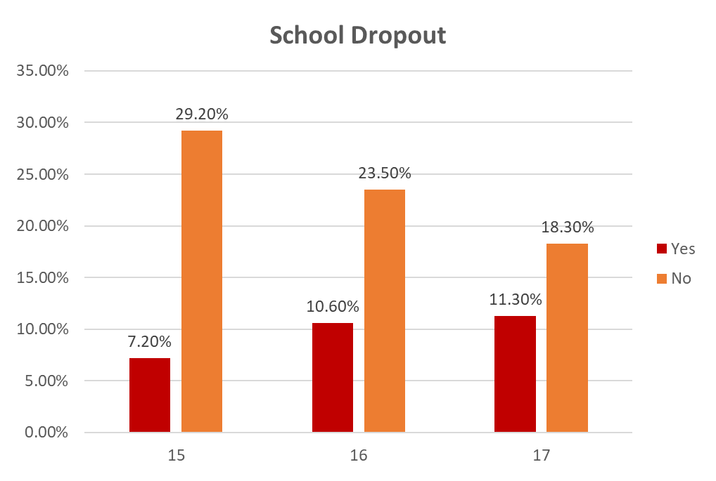
Results
AMONG 15-YEAR-OLD GIRLS, 7.20% WERE OUT OF SCHOOL AND 29.20% OF GIRLS WERE ATTENDING SCHOOL. SIMILARLY, THE PERCENTAGE OF 16 AND 17-YEAR-OLD GIRLS WERE 10.60% AND 11.30%, RESPECTIVELY

Slide 12
Results
Factors associated with school attrition of girls in Bangladesh
Age of girls is observed as an important factor for girls drop out of school; for instance, the girls aged between 17 years have a higher odds (OR=2.19, 95%, CI: [1.82,2.64]).
The rate of attrition is high among married girls, and it was 11.03 times higher (OR=11.03, 95%, CI: [9.02,13.53])
Compared with urban areas the rate of attrition in rural areas was 31% lower (OR=0.69, 95%, CI: [0.56,0.86]).
The attrition rate is very high in Sylhet 4.63 times (OR=4.60, 95%, CI: [3.32,6.41]) while Khulna holds the lowest rate and it was (OR=0.90, 95%, CI: [0.65,1.26]) than Barisal.
Notes:
Factors Associated with Attrition of Girls Students from School in Bangladesh

Slide 13
Conclusion
The current study yields solid evidence that many factors significantly increases girls’ risk of school dropout in Bangladesh.
The frequency of reporting of marriage as the main reason for school dropout are remarkable enough to warrant the conclusion that child marriage is a main driver of girls’ dropping out of school in Bangladesh.
School-based programs aimed at preventing child marriage should target girls from the fifth grade because of their escalated risk, and they need to prioritize girls from disadvantaged groups.
Schools with smaller class size, stronger relationships between students and adults, and a focused, rigorous and relevant curriculum are better as intervention measures.
The problem of attrition lies more with poverty, ignorance, mismanagement and discontinuity, rather than high-stake mal-adjustment.

Slide 14
Conclusion
Poverty alleviation, national level awareness, making curriculum more relevant, and better management of the implementation process (including reduction in class-size, solving teachers' problems of both money and expertise, and academic supervision) of education would be solution paths in Bangladesh for better retention.

Slide 15
References
M. A. Amadi, E. Role, and L. N. Makewa, “Girl Child Dropout: Experiential Teacher and Student Perceptions,” Int. J. Humanit. Soc. Sci., vol. 3, no. 5, p. 8, 2013.
R. Sabates, A. Hossain, and K. M. Lewin, Consortium for Research on Educational Access, Transitions and Equity School Drop Out in Bangladesh: New Insights from Longitudinal Evidence, no. 49. 2010.
A. H. M. Shahidul, S. M. and Karim, “Factors Contributing to School Dropout Among the Girls,” Eur. J. Res. Reflect. Educ. Sci., vol. 3, no. 2, pp. 25–36, 2015.
N. Sultana, “CAUSES OF DROPOUT OF FEMALE STUDENTS AT GRADUATE,” no. 2006, pp. 164–170, 2017.
J. W. Alspaugh, “The Effect of Transition Grade to High School, Gender, and Grade Level Upon Dropout Rates,” Am. Second. Educ., vol. 29, no. 1, pp. 2–9, 2000.
M. Nyoni, T. Nyoni, and B. Wellington Garikai, “Factors Affecting Students’ Academic Achievement in Zimbabwe’s Rural Secondary Schools: A Case Study of Marimasimbe Secondary School in Jiri Community,” Dyn. Res. Journals’ J. Econ. Financ., vol. 2, pp. 1–15, 2017.
S. M. Shahidul, “FACTORS CONTRIBUTING TO SCHOOL DROPOUT AMONG THE GIRLS : A REVIEW OF LITERATURE.” 2015.
T. Yancey, “The Multidimensionality of Schoolgirl Dropouts in Rural Bangladesh,” 2015.
S. K. Mahato, “Causes and Consequences of Child Marriage: A Perspective,” Int. J. Sci. Eng. Res., vol. 7, no. 7, pp. 698–702, 2016.

Slide 16





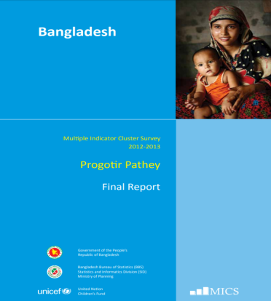
Acknowledgement

Slide 17


